Slide 1

Computer Organization And Architecture
CPEN6260010 (2 Credits)
S4-S5 A Closer Look at Instruction Set Architectures
Dr. Endra, S.Kom., M.T.
D2395

Slide 2
Learning Outcomes
LO-2: Explain the fundamental structure and operation of the Central Processing Unit (CPU), including the roles and interactions of its main components (e.g., ALU, control unit, registers) during instruction execution.
LO-3: Demonstrate the execution of simple machine instructions, showing the interactions between CPU components and memory.

Slide 3
OUTLINE
Instruction Formats
Instruction Types
Addressing Modes
Instruction Pipelining
Real-World Examples of ISAs

Slide 4
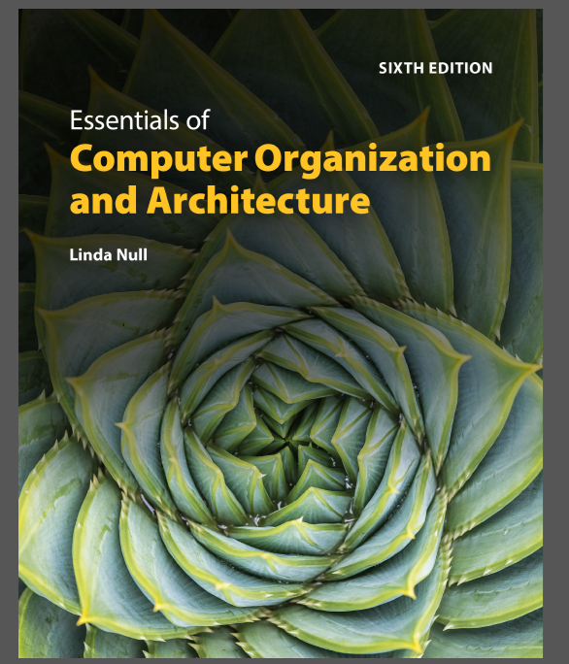
TEXTBOOK
Linda Null. (2023). Essentials of Computer Organization and Architecture with Navigate Advantage Access. Jones & Bartlett Learning. 25 Mall Road Burlington, MA 01803. ISBN: 1284259439.

Slide 5
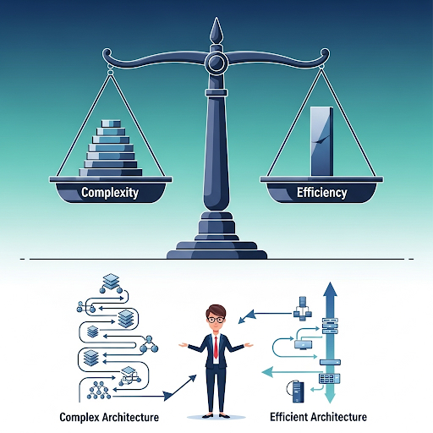
Instruction Formats
Instruction Set Design: Key Decisions
When designing an instruction set architecture (ISA), architects must make several key decisions that have long-lasting ramifications. A good ISA balances factors such as the amount of space a program requires, the complexity of decoding instructions, the instruction length, and the total number of instructions. Short instructions, for instance, are better because they take up less space in memory and can be fetched quickly

Slide 6

Instruction Formats
Little vs. Big Endian: Byte Order
The term 'endianness' refers to a computer architecture's 'byte order,' or the way the computer stores the bytes of a multiple-byte data element.
Little Endian: The least significant byte is stored first, at the lower memory address. Most PCs (Intel) are little endian.
Big Endian: The most significant byte is stored first, at the lower memory address. Most UNIX machines and newer RISC architectures are big endian.
This matters for data transfer and file formats, as the byte order must be consistent.

Slide 7
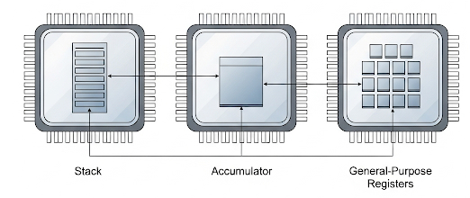
Instruction Formats
Internal Storage: Stacks vs. Registers
Architects must choose how the CPU should store data. There are three main choices:
Stack Architecture: Uses a stack where operands are implicit (e.g., zero-address instructions). Has good code density but can be a bottleneck.
Accumulator Architecture: Uses a single accumulator register for one of the operands (e.g., MARIE). Allows for very short instructions but high memory traffic.
General-Purpose Register (GPR) Architecture: Uses a set of registers that are faster than memory and easier for compilers to use. This is the most widely accepted model today.

Slide 8
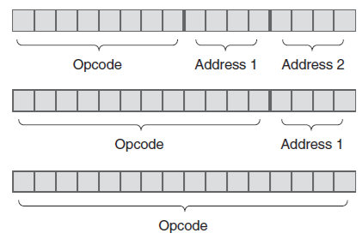
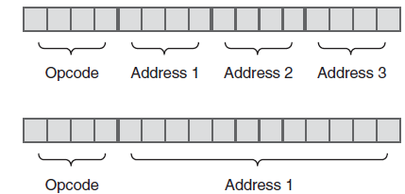
Instruction Formats
Instruction Formats: Balancing Opcodes and Operands
Instructions can be of fixed length or variable length. Fixed length is fast to decode but can waste space, while variable length saves space but is more complex to decode. A compromise is expanding opcodes, which use a variable-length opcode to provide a rich set of instructions without sacrificing space. The trick is to use an 'escape opcode' to indicate when the instruction should be interpreted as having a longer opcode.

Slide 9
Instruction Types
Instruction Types: A Functional View
Most computer instructions can be grouped into functional categories. Computer manufacturers regularly classify instructions into categories to help both programmers and system designers understand their purpose. Let's look at the main types of instructions found in a typical Instruction Set Architecture:
Data Movement: Instructions for moving data between registers, memory, and the stack. Examples include LOAD, STORE, MOVE, PUSH, and POP.
Arithmetic: Instructions for integer and floating-point arithmetic. Examples include ADD, SUBTRACT, MULTIPLY, DIVIDE, INCREMENT, and DECREMENT.
Boolean Logic & Bit Manipulation: Instructions that perform Boolean operations on bits (AND, OR, XOR) and instructions that shift or rotate bits within a data word. Examples include SHIFT, ROTATE, AND, and NOT.

Slide 10
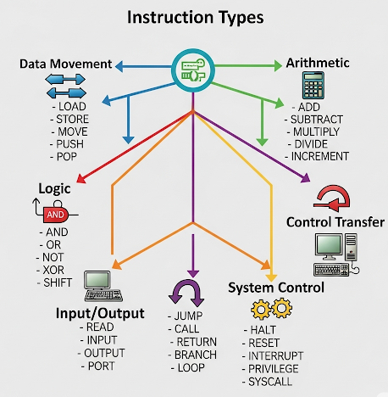
Instruction Types
Instruction Types: A Functional View
Input/Output (I/O): Instructions for transferring data between the computer’s memory and external devices like a keyboard, screen, or disk drive.
Transfer of Control: Instructions that alter the normal sequence of program execution. Examples include branches (unconditional and conditional), jumps, and procedure calls/returns.
Special-Purpose: A catch-all category for instructions that don't fit elsewhere, such as no-ops, flag control, and string processing.

Slide 11
Addressing Modes
Addressing Modes: Finding the Operand
Addressing modes allow us to specify where the instruction operands are located. They determine the operand’s effective address dynamically. Common modes include:
Immediate: The value is in the instruction itself (e.g., ADD R1, #5).
Direct: The instruction contains the memory address of the operand (e.g., LOAD R2, 1000).
Register: The operand is in a register (e.g., ADD R3, R4).
Indirect: The instruction's address field points to another memory address, which contains the real address of the operand.
Indexed: An index register value is added to the address in the instruction to find the effective address.

Slide 12
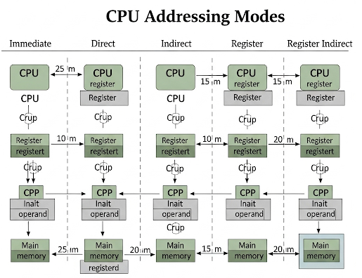
Addressing Modes
Addressing Modes: Finding the Operand

Slide 13
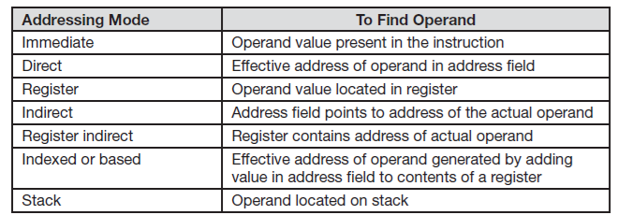
Addressing Modes
Addressing Modes: Finding the Operand

Slide 14
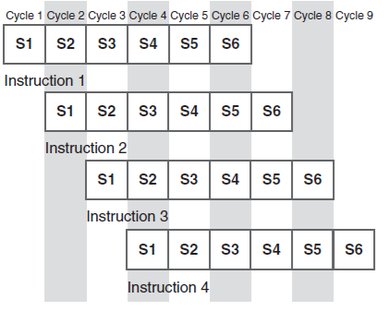
Instruction Pipelining
Instruction Pipelining: The Assembly Line of CPUs
Instruction pipelining is a method used to speed up program execution by overlapping the stages of the fetch-decode-execute cycle. It's analogous to an assembly line: different stages of the pipeline are completing different parts of different instructions at the same time. While this significantly increases throughput, potential pipeline conflicts can occur due to resource conflicts, data dependencies, or conditional branch statements, which can cause stalls and reduce efficiency.

Slide 15
Real-World Examples of ISAs
Real-World Examples: Intel, MIPS, and ARM
Real-world ISAs, such as those from Intel, MIPS, and ARM, showcase different design philosophies.
Intel uses a little endian, two-address, variable-length instruction set architecture.
MIPS is a RISC, three-address, fixed-length ISA.
ARM is the most widely used 32-bit architecture, also being a RISC, load/store machine with fixed-length, three-operand instructions. These architectures are optimized for different goals, such as backward compatibility or power efficiency, demonstrating the real-world trade-offs in design.

Slide 16
Real-World Examples of ISAs
Real-World Examples: Intel, MIPS, and ARM
Key Characteristics | Intel | MIPS | ARM
Endianness | Big-endian (historically little-endian) | Big-endian | Big-endian
Instruction Length | Variable (1-15 bytes) | Fixed (32-bit) | Fixed (32-bit, with Thumb 16-bit instructions)
Number of Operands | Variable (up to 3) | Fixed (3) | Fixed (3)
Design Philosophy | CISC | RISC | RISC

Slide 17
Evaluation
Session 4-5 Exercises
Assume you have a byte-addressable machine that uses 32-bit integers and you are storing the hex value 1234 at address 0. Show how this is stored on a big endian machine.
Convert the infix expression (2+3)×8/10 to reverse Polish (postfix) notation.
A computer has an instruction format with a total of 11 bits and an address field of 4 bits. Is it possible to have 5 two-address instructions, 45 one-address instructions, and 32 zero-address instructions using this format? Justify your answer.

Slide 18
Evaluation
Session 4-5 Exercises
4. What is the difference between using direct and indirect addressing? Give an example.
A nonpipelined system takes 200ns to process a task. The same task can be processed in a five-segment pipeline with a clock cycle of 40ns. Determine the speedup ratio of the pipeline for 200 tasks.
Write code to implement the expression A=(B+C)×(D+E) on a three-address machine."

Slide 19
Reference
Linda Null. (2023). Essentials of Computer Organization and Architecture with Navigate Advantage Access. Chapter 5: A Closer Look at Instruction Set Architectures. 25 Mall Road Burlington, MA 01803. ISBN: 1284259439.

Slide 20


